Slide 1
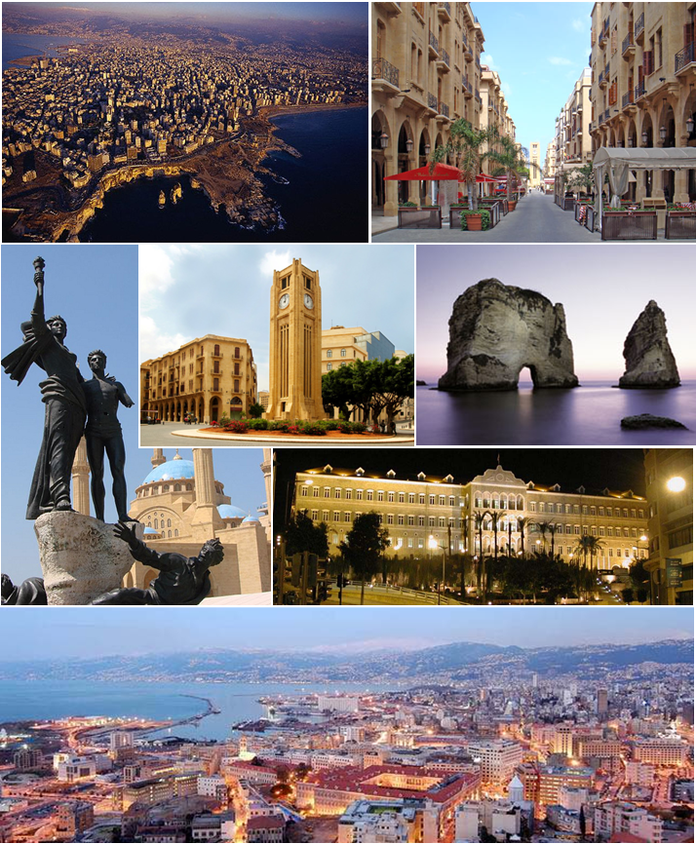
Beirut
Teaching grammar: A communicative approach
Notes:
1

Slide 2




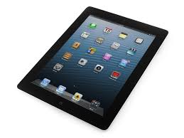

Developing Grammar Activities: Speaking
Following a discussion on burglaries, the teacher shows a picture of a living room and says:
"Today, a burglar has\ broken into this room. What do you think he has taken?" (The teacher tries to elicit responses such as he has taken the lap-top computer, he has stolen the jewellery, etc ).
Now, add descriptions of the stolen items for the police report.

Slide 3

Developing Grammar Activities: Speaking/Writing
Write a story about the following topic for the school magazine.
Imagine that you have been asleep from 2014 till 2090. You have just woken up to be shocked about everything around you. Compare your old and new lives and write your story using "used to".

Slide 4

Developing Grammar Activities: Writing
Think back to when you were a child:
"What are the differences and similarities between your life then and now? Think about where you lived, your likes/dislikes, your holidays and your family, and fill in the following lines with appropriate sentences".
Your life as a child...
___________________________________________________________________________________________________________________________________________________________________________________________________
Your present life...
___________________________________________________________________________________________________________________________________________________________________________________________________________________________

Slide 5

Developing Grammar Activities: Editing and pair editing
Think back to when you were a child:
Spot the twelve basic errors and the 5 grammar errors in this essay on career and education.
When students are done, arrange them into pairs. Each pair of students should review the work sheet - "pair edit" it. Now compare the edits you made your peers. Students must agree on the rectifications they make because each partner will earn the same grade.
A whole class activity, students can also be divided into teams. Verb cards in different tenses, one at a time, have each student come up to the front of the class and draw a card from the stack of verb cards. Then the student must act out, or "pantomime," the verb on the card.
Weather reports: Future tense
Comics
Grammar songs
Games
Newspapers
Grammar plays
Headline news
literature
Films

Slide 6

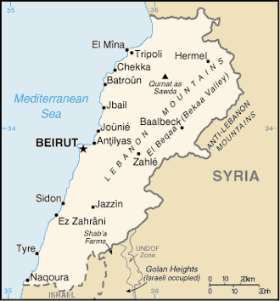

Cedar tree
Notes:
6

Slide 7
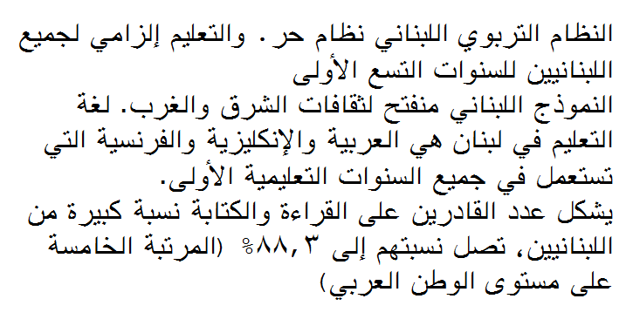
لبنان
Cultural capital
You could make a comparison between the British educational system and the Lebanese one.
You could create a table and list subjects studied in Lebanon and those studied in Britain in secondary/primary.
Notes:
7

Slide 8
GCSE subjects in the UK compared to Morocco
المواد الإجبارية في بريطانيا
المواد الإجبارية في المغرب
اللغة الإنجليزية
اللغة العربية
علم الأحياء
اللغة الإنجليزية
علم الكيمياء
علم الأحياء
علم الفيزياء
علم الكيمياء
الرياضيات
علم الفيزياء
اختيارية
الرياضيات
الرياضة
الفنون
اللغة الفرنسية
الرياضة
التاريخ
اللغة الفرنسية
الجغرافيا
التكنلوجيا
التربية الدينية
التاريخ
الفلسفة
اللغة الإسبانية
الجغرافيا
التربية الدينية
Notes:
8
8

