Slide 1
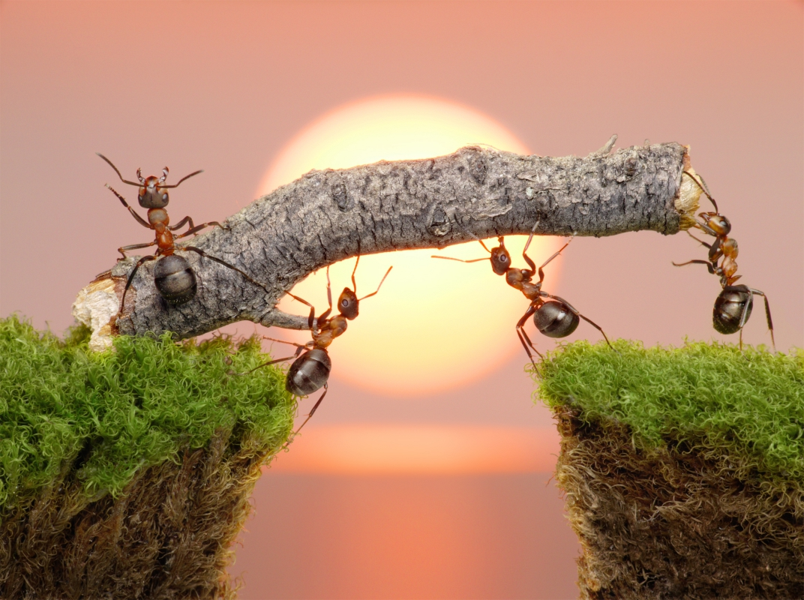
Group work
Notes:
1
1
1
1

Slide 2
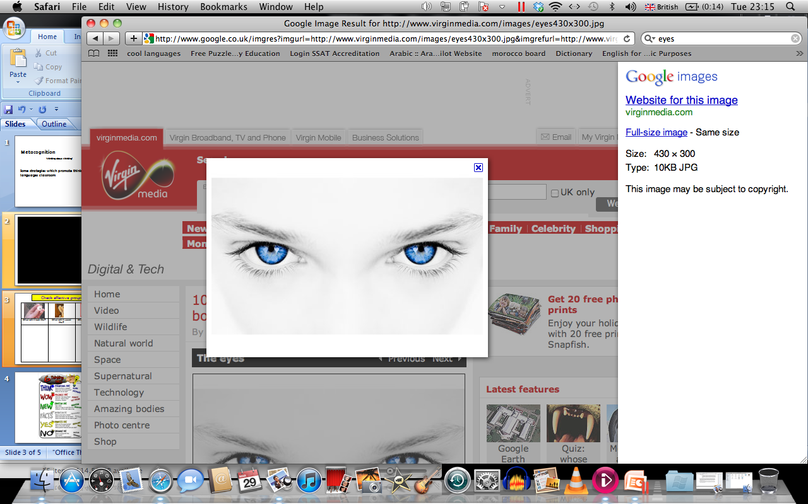

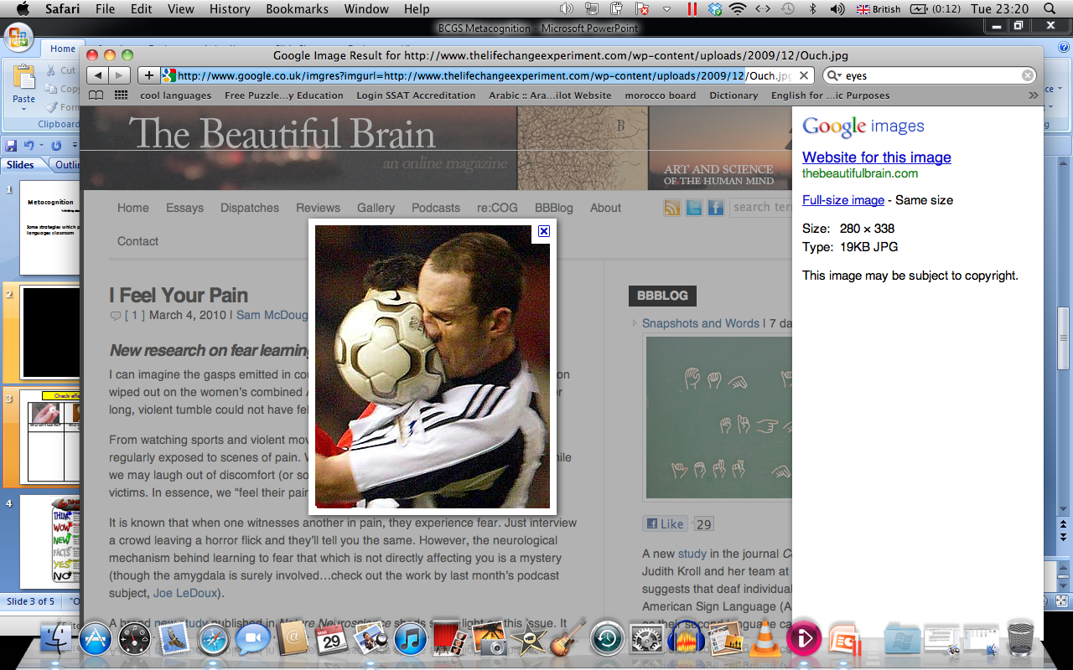
What is effective group work? Write as many ideas as possible
Unlike whole class activities group activities allow student to talk about 25 percent of the time. In pairs, each student can talk about 50 percent of the time. If students want to improve their speaking skills, there’s no substitute for pair and group work.
What will it look like? | What will it sound like? | What will it feel like?
funny
hardworking
acting
you have to be brave
challenging
interesting
clever
exciting
Win! Win!
fantastic
eye catching
exciting
loud
team-work
confident
talented
organised
confident
laugh
enjoyable
energetic
happy
every member matters
circus
active
clever
Notes:
Great for establishing success criteria
2

Slide 3
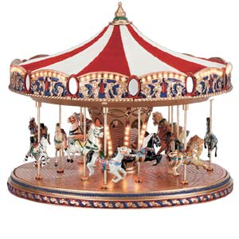
Carousel
Student:
Four/five different activities.
Four/five groups.
Each group spends 10 minutes per activity and moves onto the next when instructed to do so.
The activities are learner led and teacher acts as a facilitator.
Teacher:
Verbal, short cycle feedback

Slide 4

The big dip!!! Breaking through to success
* Each group is allowed two questions to get out of the big dip
* Use your questions wisely ☺

Slide 5

Speaking: Role plays
Some students feel less reserved if they have a role to play, and can escape from “being themselves”.
Role plays may involve students playing a tourist/tour guide, boss/employee, customer/post office clerk
Pair work: imagine both of you want to meet later. Sit back to back and role-play a phone call. Use these questions and your own ideas:
Where are you?
What are you doing?
Who are you with?
Where should we meet?
“Hi, this is Pete. Could I speak to Marc?”
“Speaking. Hey, Pete, where are you?”
“I’m still at home. What are you doing?”
Remember: Some students may not enjoy pretending to be someone else

Slide 6
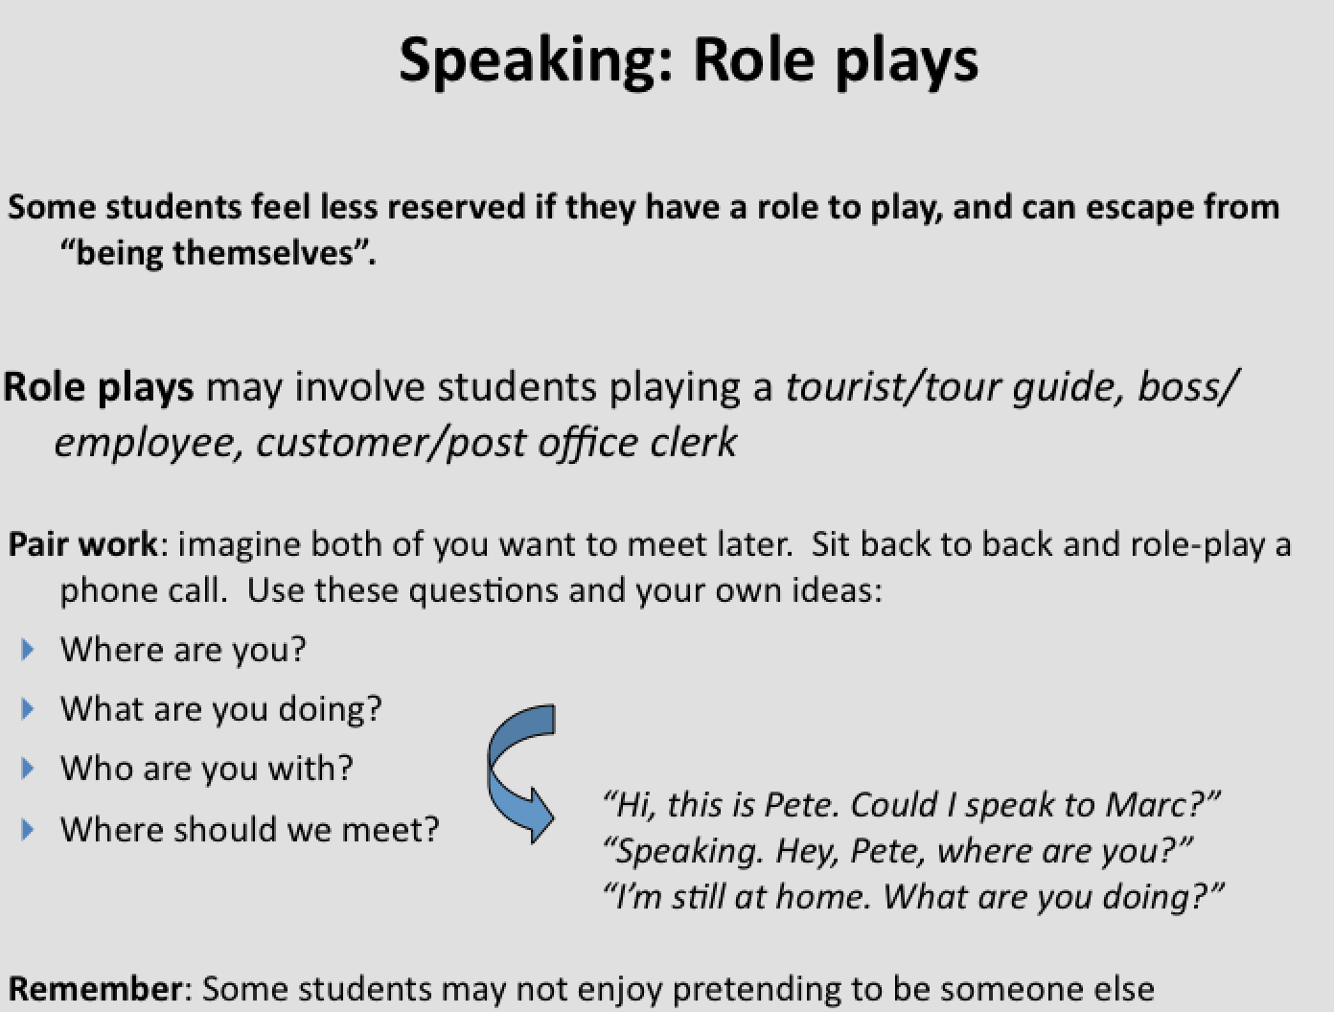
Speaking: Role plays
Other contexts
Health and happiness: At the doctors surgery
Media travel and culture: Booking a room in a hotel or a flight/asking for directions/tour guide
Career and professions: A job interview/work experience interview/
Hobbies and interests: a telephone conversation with an Arab pen-friend
News and Media: News report/
The environment: Weather report

Slide 7
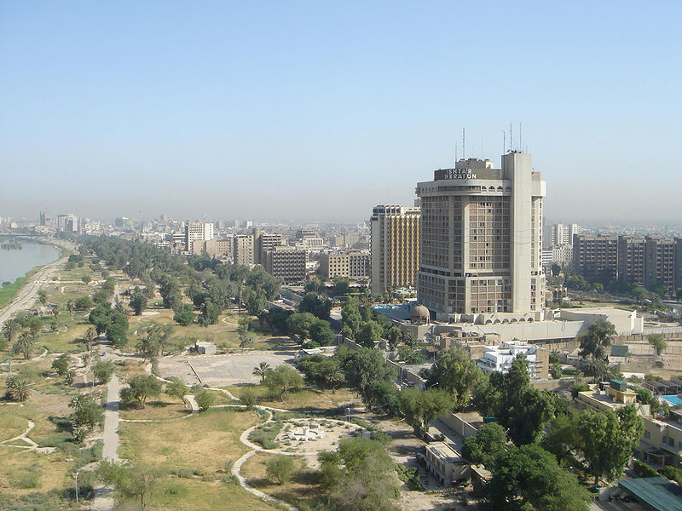
Baghdad
تكلم
أُكْتُب
Notes:
7
7
7
7

Slide 8

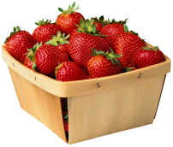
Food and drink:
Create a Menu.
On the front cover, name the restaurant and the origin of the
type food your restaurant represents.
2. On the inside right corner list appetisers, salads, and
sandwiches with prices.
3. On the inside left corner, list the entrees, broken down into meat,
seafood, and vegetarian. Add side dishes and drinks with prices
at the bottom.
4. On the back cover, give a brief history of your restaurant. Why
your restaurant is good and what would diners expect from
their visit.
Notes:
8
8

Slide 9

Writing and speaking:
Media: My favourite TV show sucked me right out of the sofa and into its script. I...
"I woke up this morning and heard on the news that school was cancelled. I..."
Pets: Our dog had puppies. I posted a sign that announced free puppies. It said ...
Food and drink: I opened my lunch box today and ...
Write a story entitled "time machine"
"Once I dreamed my cat could talk. She was hilarious! She said... "
“Happiness is...” Expand and elaborate.
Write a story entitled "the best day of my life"
The school day should end right after lunch because ..
Notes:
9
9

Slide 10
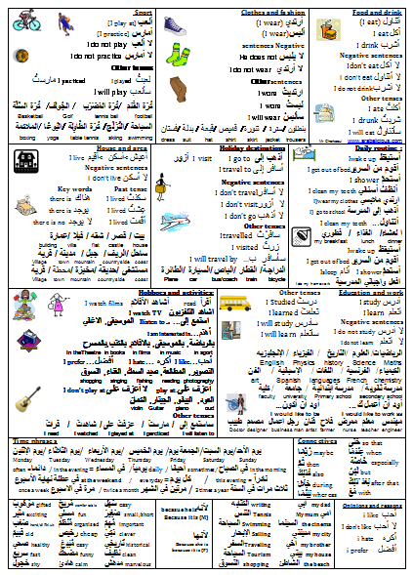

Other ideas for speaking and writing:
Eight key GCSE topics on 1 sheets
Includes generic languages
Includes opinions and reasons
Model use its use to learners

Slide 11


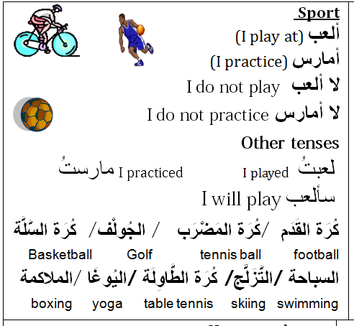


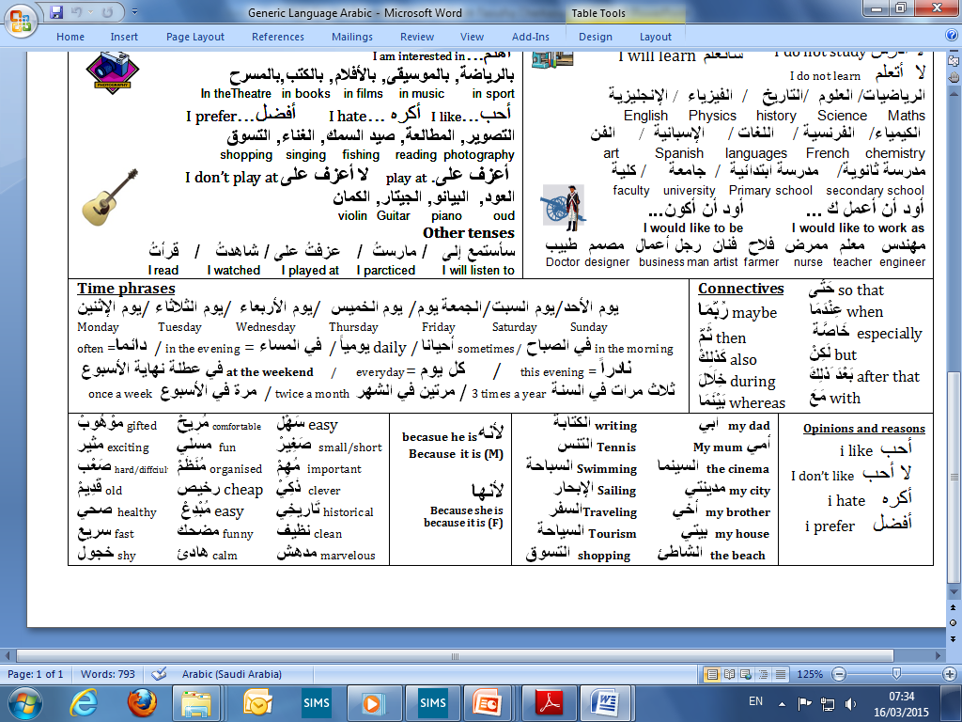





Other ideas for speaking and writing:
غالباً
أحياناً
الرَّقْص
بالحَاسُوب
أَلْعَبُ
Often
الخميس
sometimes
أَمارس
الثلاثاء
I practice
I play
Tuesday
Thursday
Add days
كُرة القَدَم
أَلْعَبُ
التّسَوُّقْ
أَذْهَبُ إلَى
السَّبْت
يوم
I play
I go to
Saturday
التِّلْفَاز
أَشاهد
الكُتُبْ
أقرأ
الْإِثنَين
الأربعَاء
I watch
I read
Monday
Wednesday
المُوسِيقَى
أَسْتَمِعُ إلَى
مرة واحدة في الاسبوع
السِّينِمَا
أَذْهَبُ إلَى
I listen to
Once a week
I go to
خمس مرات في الأسبوع
أخْتِي
جَدِّي
With whom?
الحمَّام
الطَّعَام
غرفة
Where?
مَعَ
My sister
My granddad
bathroom
Dining room
في
أبِي
جَدَّتِي
أخِي
النَّوْم
غرفة
المدينة
المكتَب
My dad
My grandma
My brother
bedroom
Town/city
office
صَديقي
أمِّي
صَديقتِي
الحدِيقَة
الجُلوس
غرفة
My friend
My mum
My friend (F)
Garden/park
Living room

Slide 12
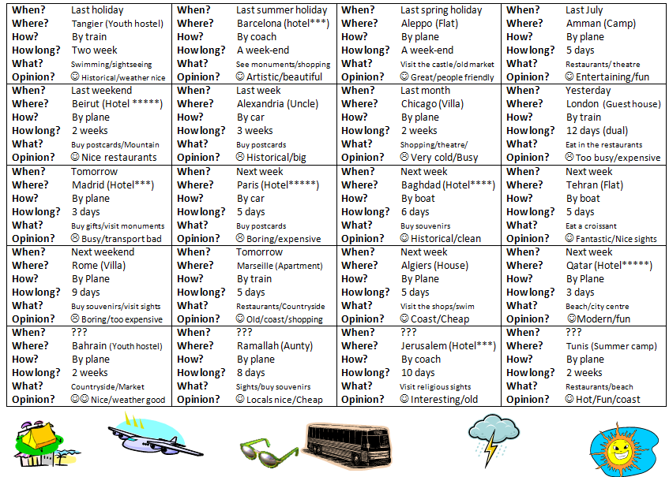

Other ideas for speaking and writing:
Useful to prepare students for their speaking and writing assessments
Can be adapted to many other topics
Useful homeworkk sheet
Reminds students of expectations
Can provide students with ideas and encourage creativity

Slide 13

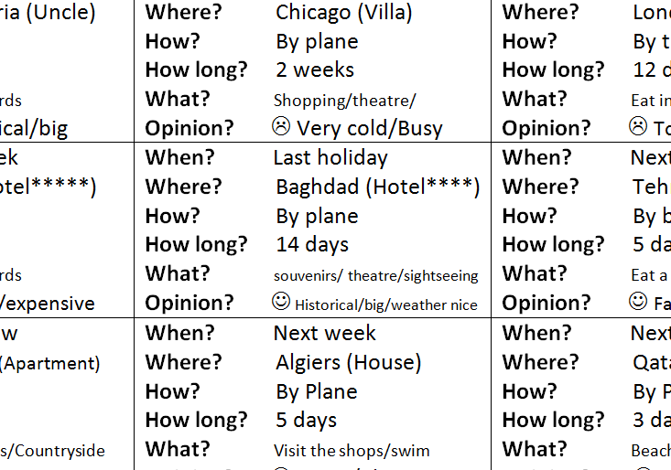
Other ideas for speaking and writing:
بغداد
السنة الماضية سافرت إلى...
Baghdad
Last year I traveled to…
أسرتي
و
أصدقائي
مع
سافرت
My family
My friends
With
And
عريقة
تاريخية
قديمة
كانت مدينة...
Old
Historical
Old
The city was…
مملة
الرحلة
Boring
وَ
غير
كانت
وَ
بالطائرة
سافرنا
Trip
مريحة
and
Not
السفرة
Was
and
By plane
We traveled
Comfortable
Trip
في الصباح
مراكز تسوق
ذهبنا إلى
وسط المدينة
في
فاخرة
In the morning
Shopping centers
We went to
في المساء
The city centre
Luxurious
ضواحي المدينة
في
معالم تاريخية
زرنا
بعد ذلك
In the evening
The outskirts of the city
in
Historical sites
We visited
After that
كان الطقس
أربعة
فندق
في
نزلنا في ...
مشمس
وَ
جميل
نجوم
and
The weather was
stars
4
A hotel
in
We stayed in…
Sunny
Nice

Slide 14
Other ideas
kinaesthetic’ activities
Age and month of the year: Students to stand in line according to how old they are, starting with the youngest in the class and ending with the oldest
Vocabulary game: Divide the class into 4/5 groups, give each student an A4 sheet. Each student to write a letter randomly.
Now, students, in each group, have 5 minutes to stand in lines, holding their letters in front of them so that they spell words. How many words can they get? Assign a ‘judge’ to verify the words are spelt correctly and keep score.
School open evening: In groups, students prepare a school open evening presentation/flip chart. Subjects offered at school/university, available facilities, quality of teaching and learning (results), activities, trips, partnerships etc...
When the task is complete students walk around and play the role of parents.
Award stars for clear presentation (relevant content, visual displays that made the ideas clear and memorable).
Other possible topics
Open evening for a new gym
New youth club
Why should people visit your region
New TV channel
Food festival in your town/region
Notes:
14
14

