Slide 1
Damascus
أُكْتُب
Write
تكلم
Speak
Notes:
1

Slide 2

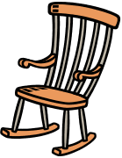





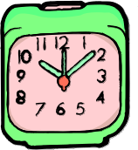


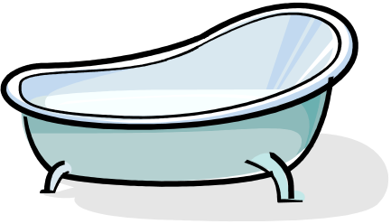


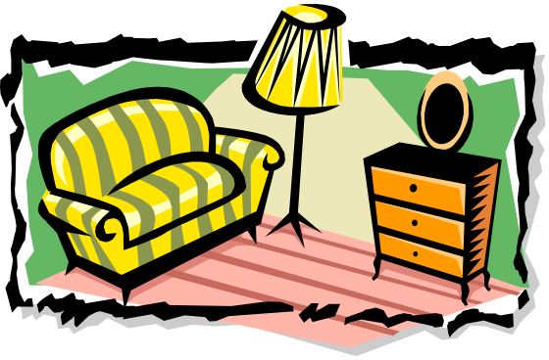
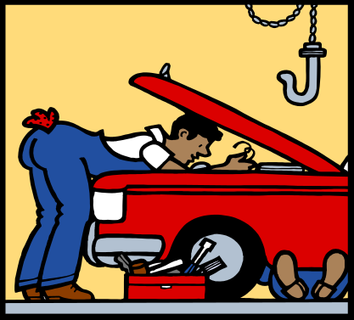
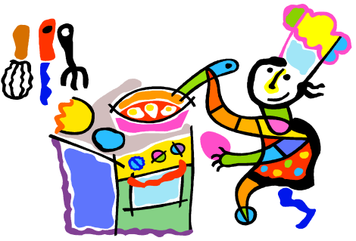



untidy
huge
new
big
tidy
old
medium sized
small
beautiful
Write what rooms are in this house?
Add colour?
Add furniture + prepositions?
Now, describe each room in this house?
Say what you don’t have in this house?

Slide 3
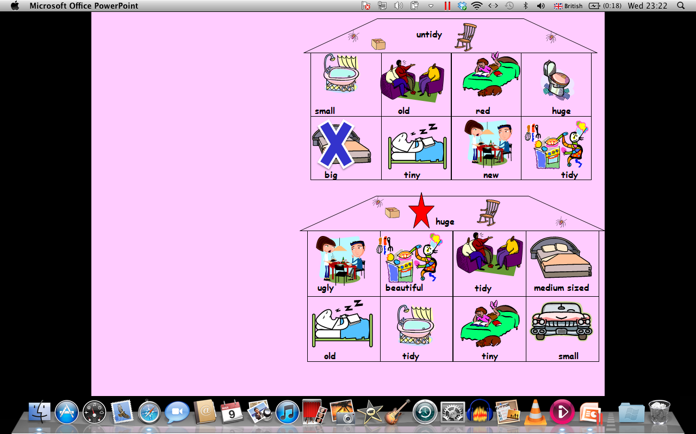
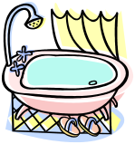
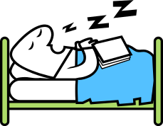

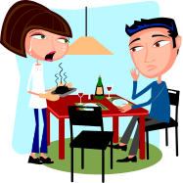
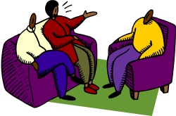

Sitting
Office
Big
Beautiful
And
Comfortable
الجُلُوس
مَكْتَب
كَبيرٌ
جَمِيلٌ
وَ
مُرِيحٌ
untidy
House A
small
old
red
huge
Smart
New
Untidy
I like
I hate
أنيق
جديد
غيرمرتب
أحب
أكره
big
tiny
new
tidy
House B
huge
There Also
Kitchen
Room
Dining
هُنَاكَ
أَيْضا
مَطْبَخ
غرفَة الطَّعَام
Small huge
red
old
big
صغير
ضخم
أحمر
قديم
كبير
ugly
beautiful
tidy
medium sized
old
tidy
tiny
small
Notes:
3

Slide 4
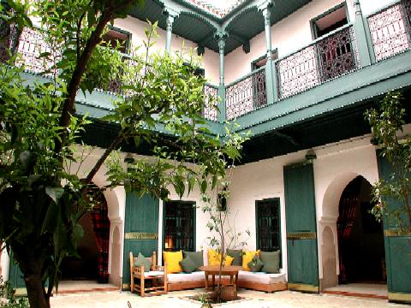
Arabic homes: Ryad

Slide 5
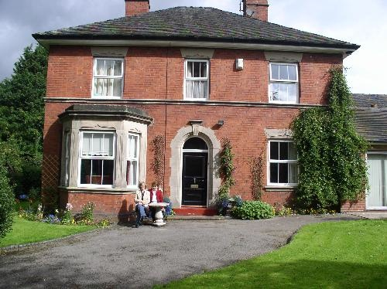
British homes.

Slide 6
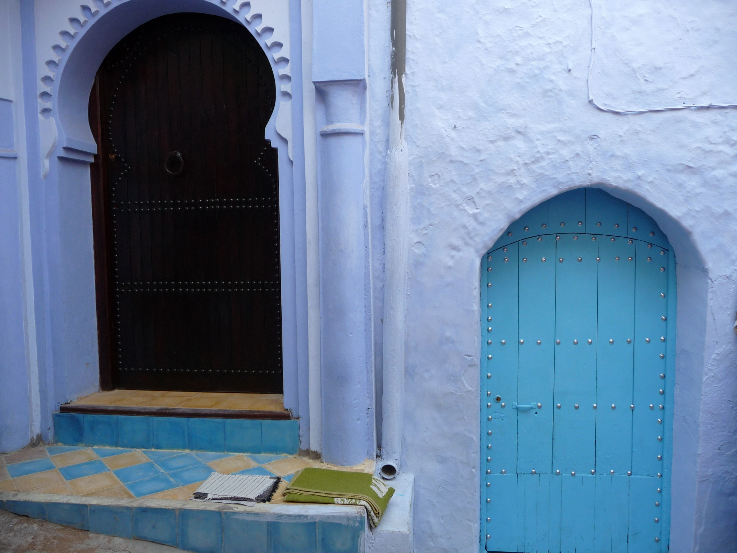
Homes
Chefchaouen

Slide 7
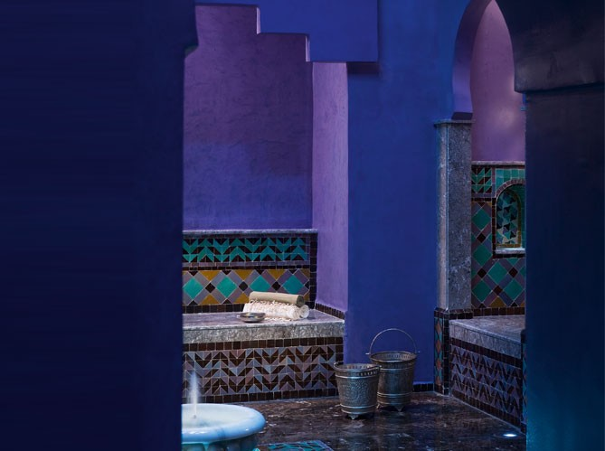
Bathrooms: Hammam

Slide 8
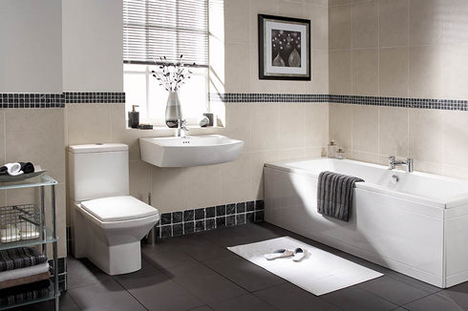
Western bathrooms
Other ideas for comparison
Police uniform
Nurses uniform
Schools
Streets
Public buses
Taxis in different Arab cities vs London taxi

