Slide 1
Algiers
A different kind of listening activity

Slide 2
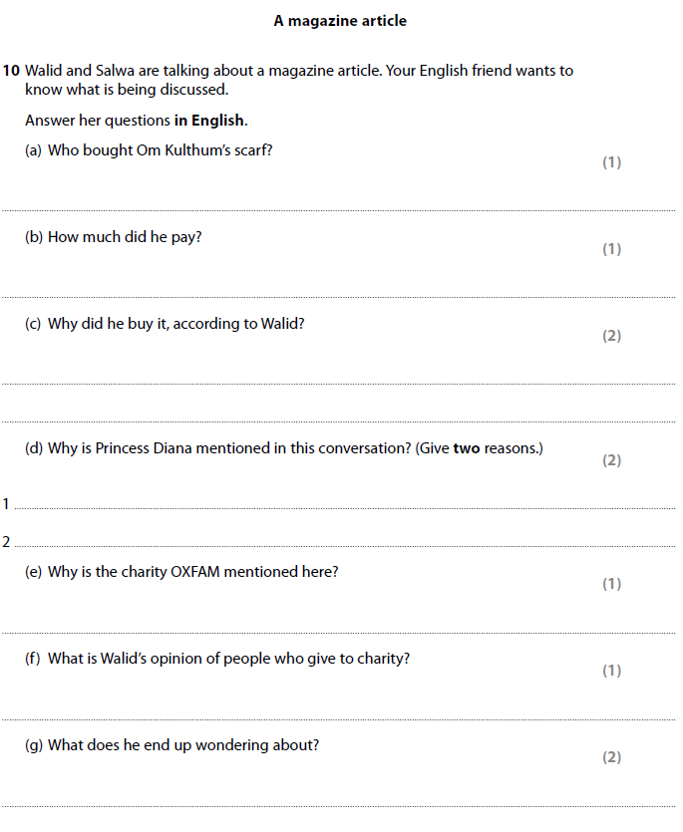

Listening: A different kind of listening activity
Some students can feel isolated,
especially if they don’t understand
the content
Look at the questions and try to
guess some of the answers, maybe
pencilling them.

Slide 3

Listening: A different kind of listening activity
Now, listen to the recording and write the answers
In pairs: Students compare their answers. Some they’ll agree on, some neither of them will get. A short discussion will ensue to convince one another
To settle the arguments: Play the recording again
Again, compare your answers. Further discussion may ensue. Is it necessary to play the recording again?
The whole class discusses the answers – Deal with any questions that come up
If there is time, play the recording again for the last time. This time students listen alone feeling pleased that they now understand most or even all of the conversation

Slide 4
Listening: A different kind of listening activity
 | When? | Where? | How? | Opinions/R
John
Samir
Maria
Lubna
In the following example, the students have listened to 4 people talking about their holidays
Pair work: Discuss these questions: Drawing in students experiences.
Have you had a holiday like John, Marie, Chris or Michael? What happened?
What did you do on your last holiday?
What is the best holiday you have even had?

Slide 5
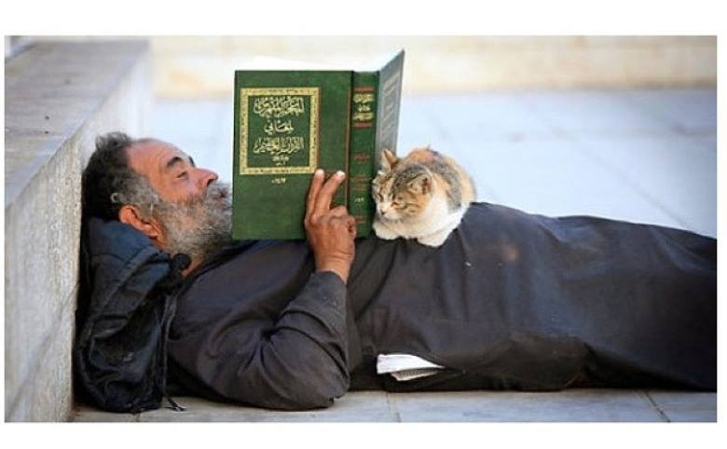
A different kind of reading

Slide 6
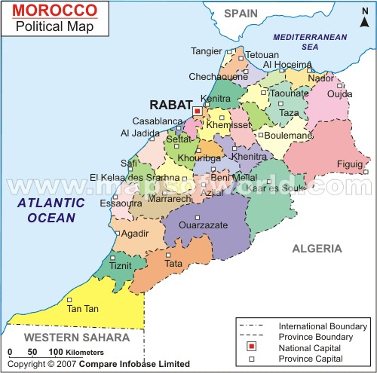

Slide 7
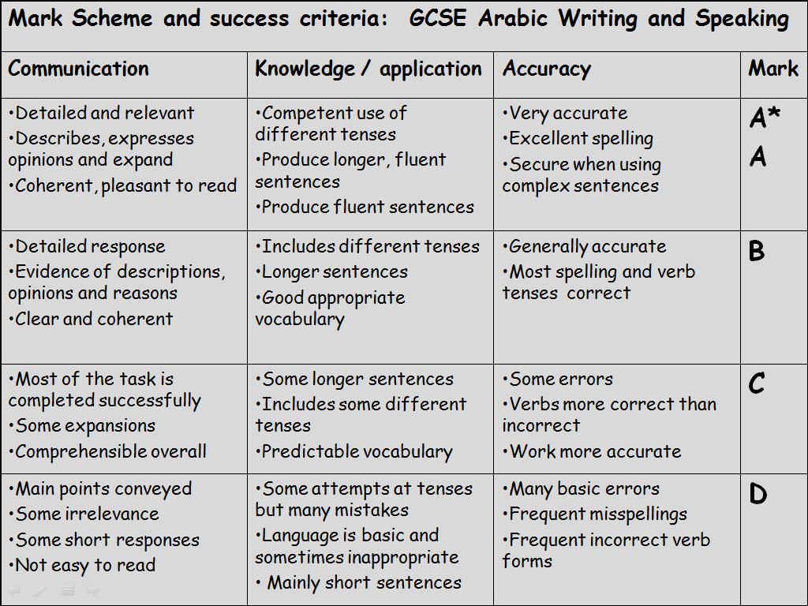
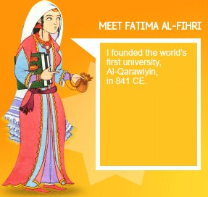
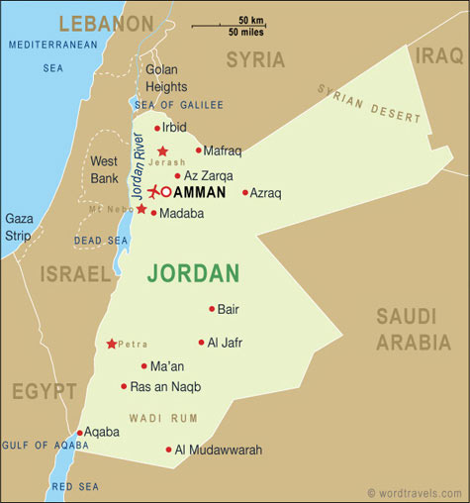
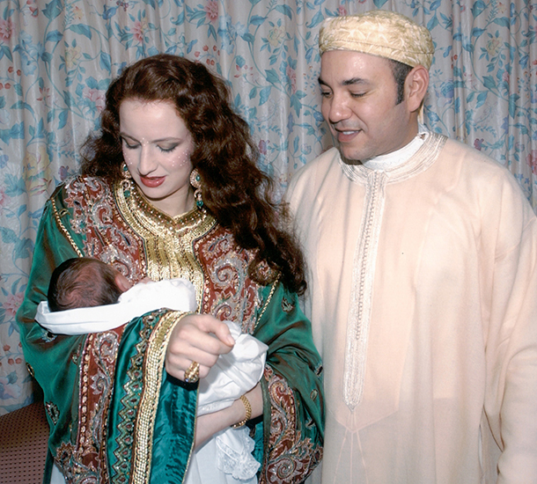
Question 17: Underline any opinions and label with ‘o'
Question 12: underline all adjectives and label with ‘A'
Question 13: Label the adjectives with ‘M’ for masculine and ‘F’ for feminine
Question 14: Circle all verbs and label with ‘V'
Question 15: Underline all time phrases and label with ‘T'
Question 16: Underline all intensifiers and label with ‘i'
Question 1: Read the text and answer the questions in English?
إسمي سلمى وأنا مغربية وأسكن في مدينة فاس. مدينتي كبيرة ونظيفة
أسكن في بيت ضخم وحديث. في بيتي يوجد ستة غرف كبيرة وأنيقة
في الطابق الأرضي هناك مطبخ صغير وغرفة جلوس. في غرفة
الجلوس يوجد أريكة وتلفاز ضخم جدا. أحب غرفة الجلوس لأنها جميلة
في الطابق الأول هناك غرفتي وغرفة أبي وأمي. في غرفتي يوجد
ساعة وسرير كبير وسجادة وشباك جميلة. هناك أيضا حمام صغيرجدا
كل يوم أستحم في الحمام ثم أرتدي ملابسي في غرفتي. في المساء أفعل
واجباتي في المكتب وأحيانا أشاهد التلفاز في غرفة الجلوس مع أخي وأختي
في يوم السبت أتناول فطوري مع عائلتي في غرفة الطعام
أحب بيتي لأنه جميل ومريح جدا
Where is Salma from? 2. What is her town like
3. Describe Salma’s house? 4. What’s on the ground floor
5. What’s on the first floor? 6. What’s in Salma’s room?
7. What does Salma do everyday? 8. What does she do in the evening?
9. What does Salma do on Saturday? 10. Does she like her house? Why?
1. Salma is from Fes in Morocco
7. Everyday Salma has a shower then she wears her clothes in her room
2. Her town is big and clean
3. Salma’s house is huge and modern
8. She does her homework in the office then she watches TV with her brother and sister
Question 11: Spot the mistake
Feedback
4. On the ground floor there is a small kitchen and a living room
9. On Saturday Salma eats breakfast with her family in the dining room
5. On the first floor there is her room and her mum and dad’s room
10. She likes her house because it is nice and very comfortable
6. In her room there is a clock, a big bed, a rug and a nice window

Slide 8
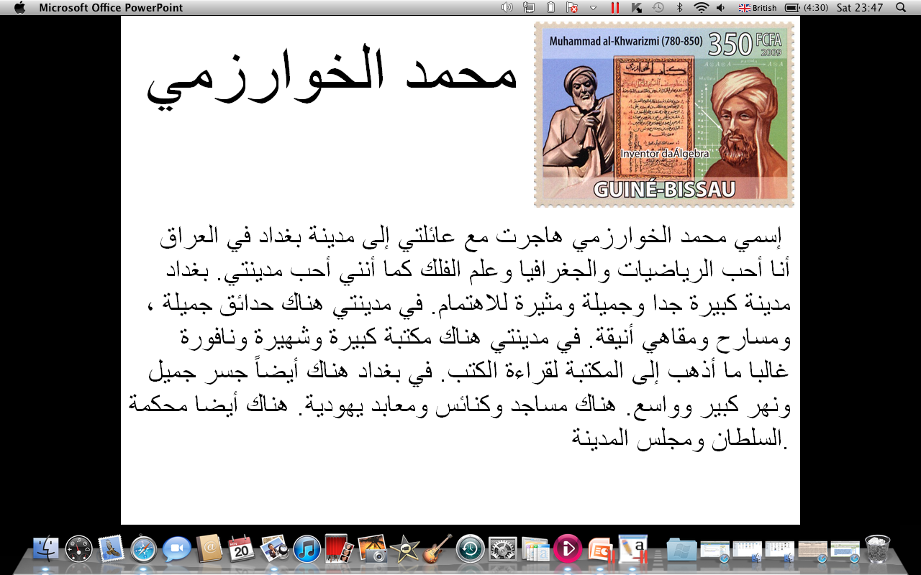
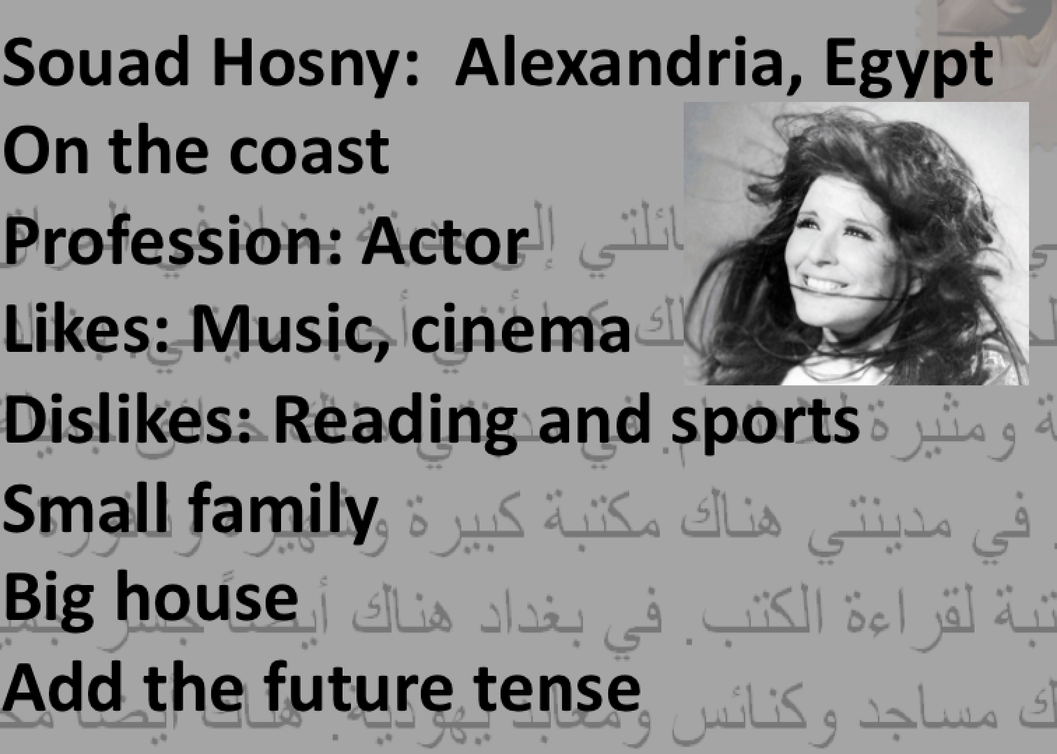
Notes:
8

Slide 9
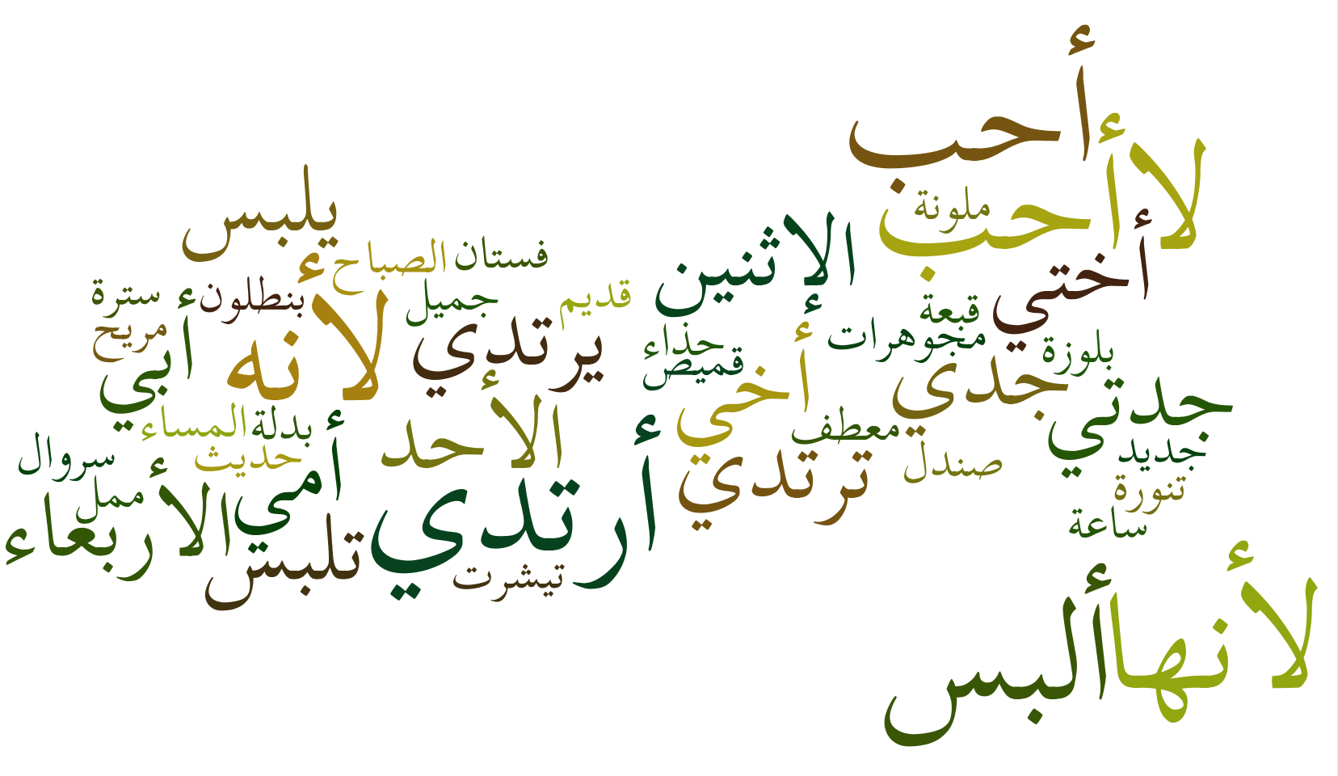

Reading: A different kind of reading activity
Learner-centred: Ask students to create similar activities for their peers.
What is the text talking about?
Where and when is the story set?
What tenses are used in the text?
Use the content to write a text about
How many brothers does she have?
What colour is her parents hair?
Who works in a hospital?
Content of Wordclouds will depend on the level and ability of students
www.wordle.net

Slide 10
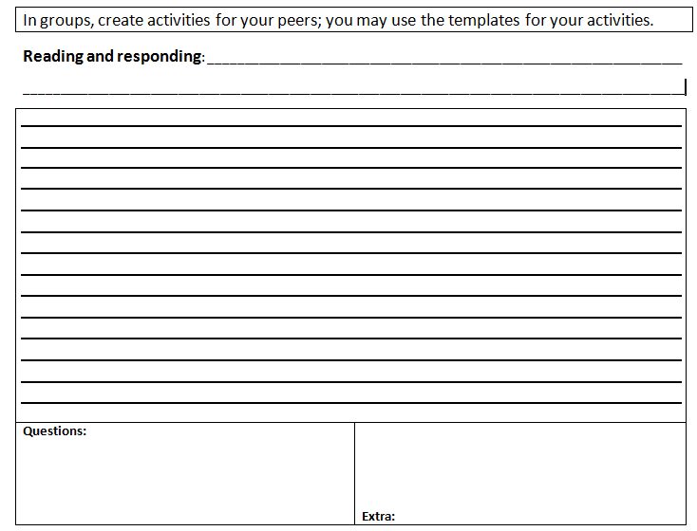
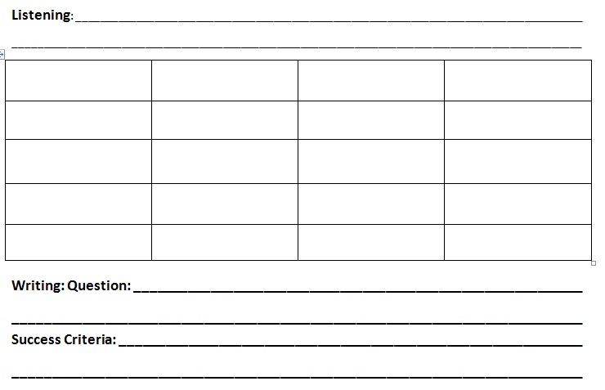
Learner-centred: Ask the students to create similar activities for their peers.
Student’s own experiences form the content
Students choose content
Often students have more/better ideas than teachers
Higher thinking order

