Slide 1


Taoufiq Cherkaoui
Principal Examiner, Edexcel Pearson
Consultant and Bilingual Trainer, University of Cambridge CIE
Arabic Advisor, British Council
Lead Practitioner Arabic, French and Assessment for Leaning
www.arabalicious.com

Slide 2

Native speakers
CIA World Fact Book
Mandarin 12.65%
Spanish 4.93%
English 4.91%
Arabic 3.31%
Hindi 2.73%
Bengali 2.71% Portuguese 2.67% Russian 2.16%
Japanese 1.83% German 1.35%

Slide 3

Learning styles and learner preferences

Slide 4
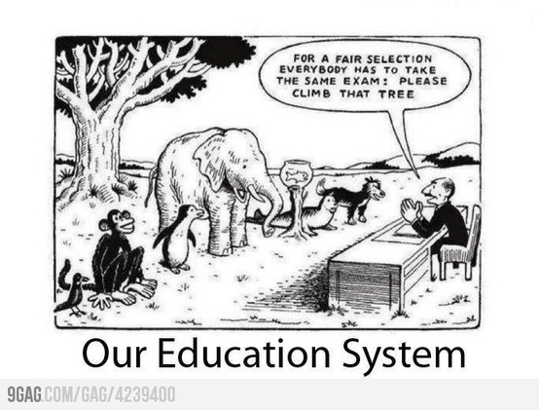
Different learners different learning styles/needs.
Provisions, targets and expectations
Multiple intelligences theory

Slide 5
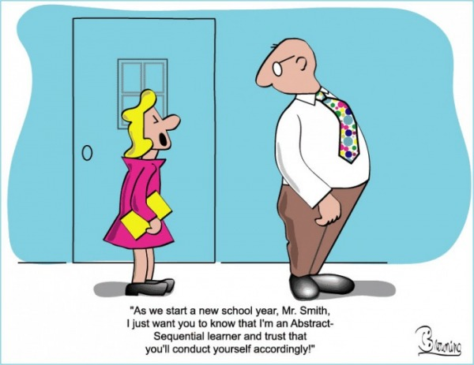
Learning styles and learner preferences

Slide 6
How do you learn best?
What do you typically do to reduce stress?
Listen to music
Walk
Talk to friends
Read
Draw
Dance
How do you play? What form does it take?
physical
organised
spontaneous
scripted
Alone
with people
Do you always approach problems or new learning in the same way, or do you like new approaches/things?
Have your preferences changed?
Have you changed?!
Before committing to learn something new, do you analyse its…
contribution to your life
cost
value
relevance
Note: When thinking about your responses to these questions, consider how you find yourself in learning situations in which your learning preferences are recognised, supported and extended. Alternatively, consider how you would feel if they are overlooked and dismissed.

Slide 7

A
Addressing learners specific learning needs
B
Qualitative and quantitative data collection
Stick four A4 Sheets labelled A,B, C and D on four different corners of the class. Participants should go and stand by the correct letter.
Teacher asks a few questions of this nature.
What are you learning preferences?
A: Visual B: Aural C: Verbal D: Physical (kinaesthetic)
What tasks and activities you find most difficult?
A: Listening B: Reading C: Writing D: Speaking
Other questions
A = Never , D = Always
I get clear responses to what I say in class; I find out how to improve.
feel encouraged to participate in section and respond to others.
I understand what is expected of me in preparation and participation.
C
D
The writing assignments are clear to me; I know what the task is.
I am usually well-prepared for class.

Slide 8


21st century learner
tactile
visual
reflective
intuitive
curious
social
global
critical thinker
autonomous
perceiver
active
more choices
more freedom

Slide 9

Effective teachers…
know how to model effective
teaching and learning skills
are learners
know their learners
highly reflective
see teaching and learning
as partnerships
have positive relationships
with their learners
believe students should
have choices
honor student voices
experts in their field
Listen to their students
inspire and motivate their learners

Slide 10

Key features of AFL
Questioning is used to promote further learning, thinking and reflection.
Learners are aware of short & long term goals.
Learners use feedback to reflect on and improve their work. They know success criteria.
Learners know why they are learning things.
Teachers allow time for all learners to reflect on learning.
Learners can judge their own level of understanding at key points in the lesson
Learners can analyse and explain key concepts to others.
Teachers model good and bad work.
Lessons are adjusted to address misconceptions and weaknesses. Schemes of work are NOT set in stone.
Learners can act independently to improve their own work.

