Slide 1
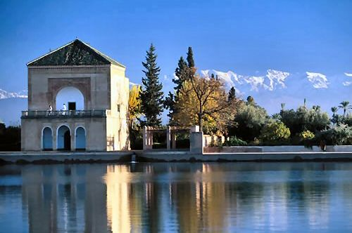
Marrakech
Atlas mountains
Find the texts and answer the questions

Slide 2
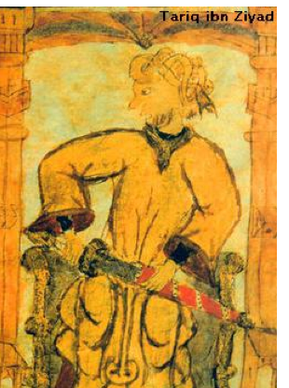
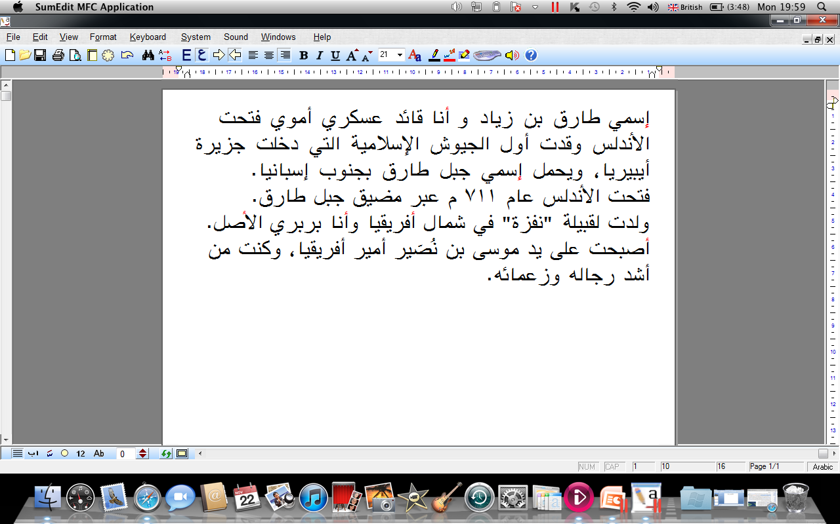
طارق بن زياد
Notes:
2

Slide 3
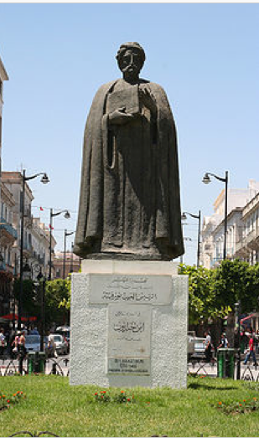
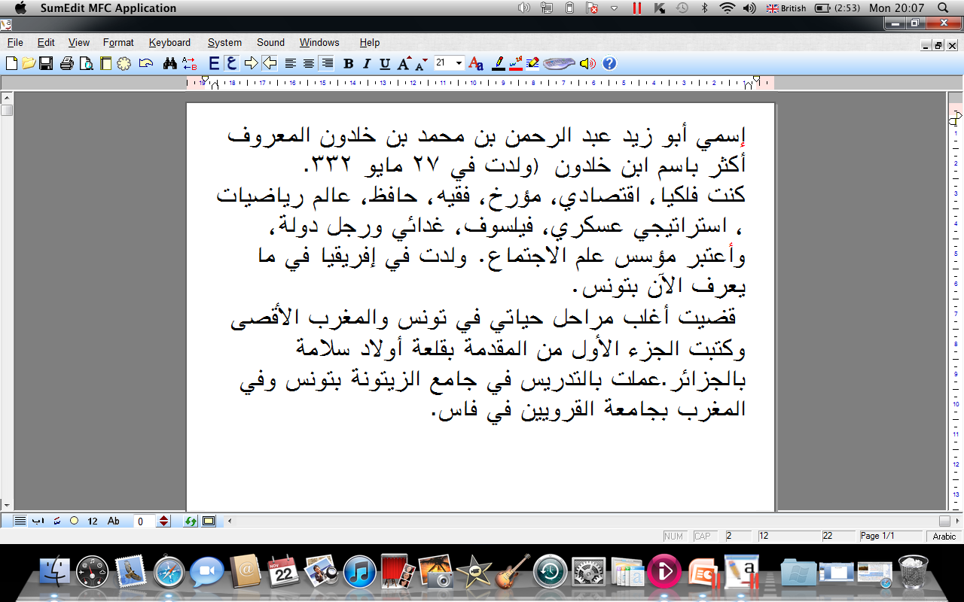
إبن خلدون
Notes:
3

Slide 4
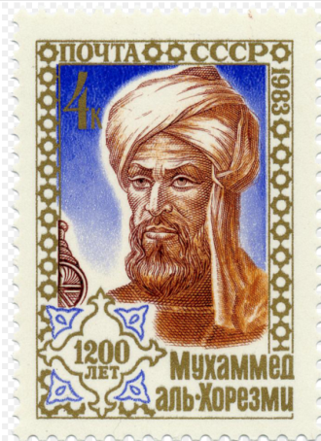
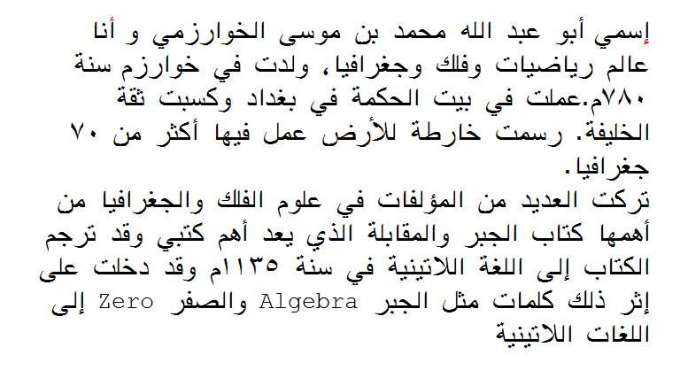
محمد الخوارزمي
Notes:
4

Slide 5
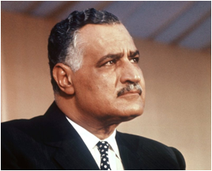
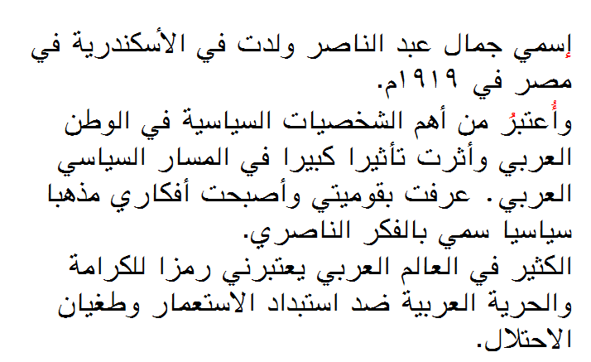
جمال عبد الناصر
Notes:
5

Slide 6
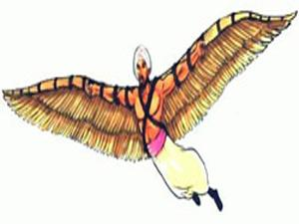
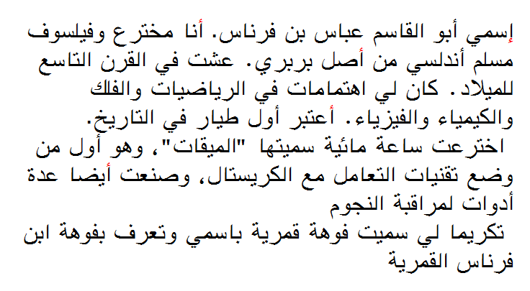
عباس بن فرناس
Notes:
6

Slide 7
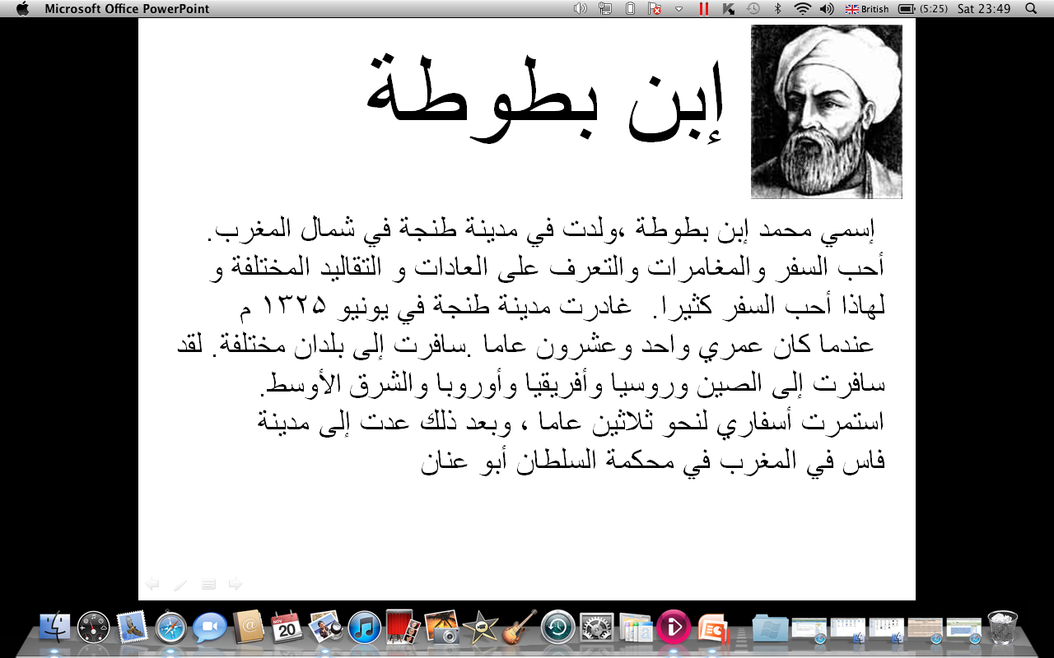
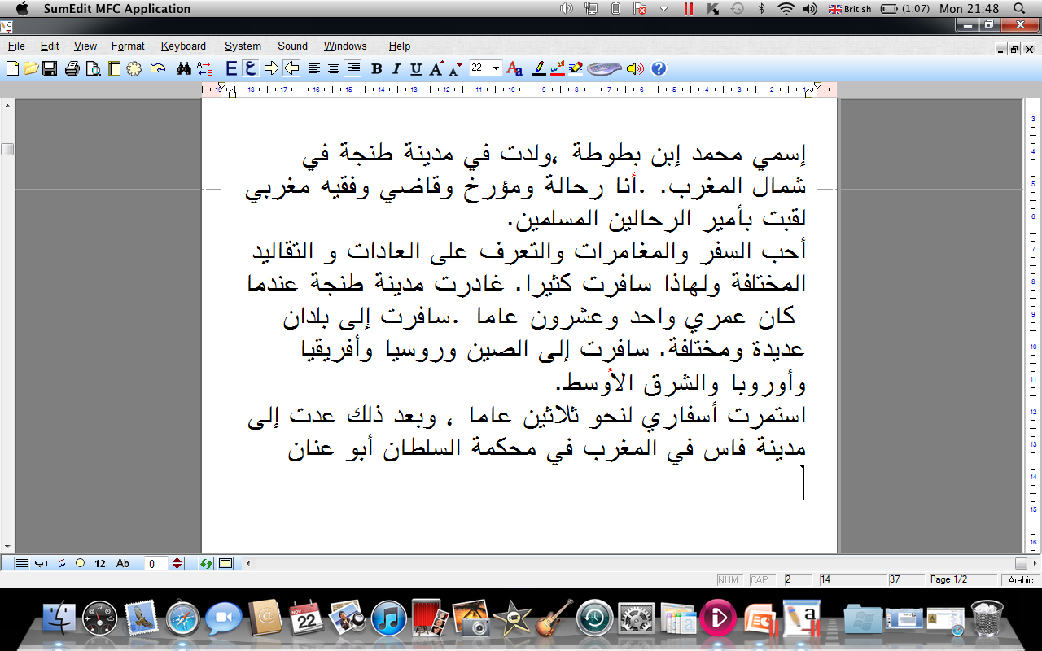
Notes:
7
7

Slide 8

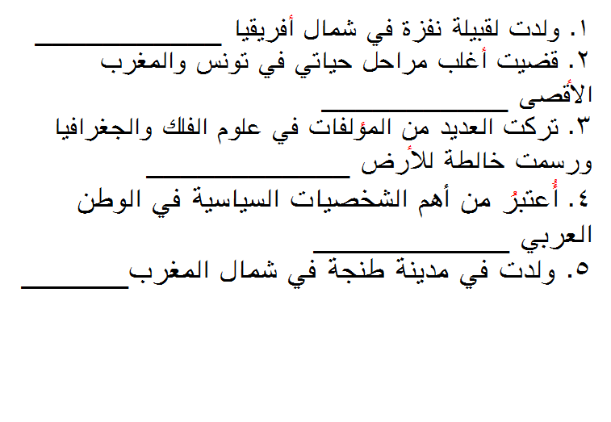

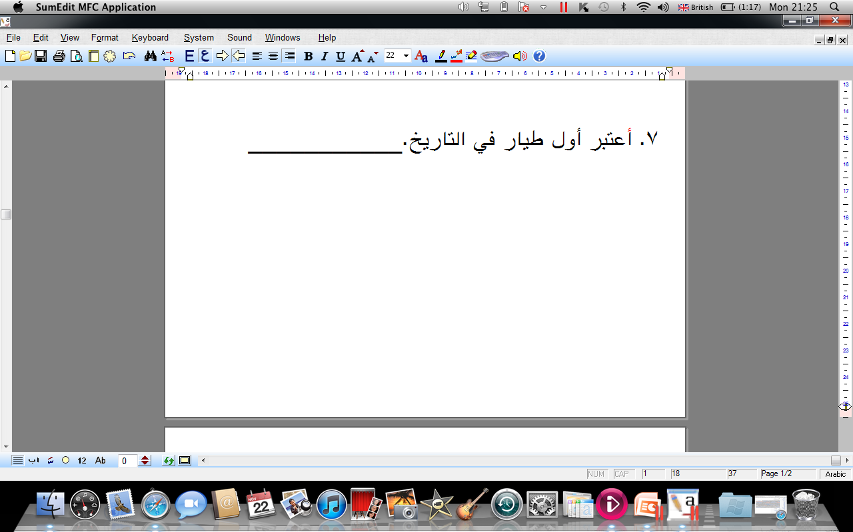
Read the statements and label with the right name
طارق بن زياد
إبن خلدون
محمد الخوارزمي
جمال عبد الناصر
إبن بطوطة
عباس بن فرناس
Notes:
8

Slide 9
طارق بن زياد
My name is Tariq Son of Zyad and I am a
Moorish general.
I led the Moorish troops to the conquest of
Spain; I Conquered Andalusia in 711.
I was born in ‘Nafza’ in North Africa and I am
of Berber origin.
During the rule of Musa Ibn Nusayr I became
the prince of North Africa.
Notes:
9

Slide 10
إبن خلدون
My name is Abu Zayd Mohammed Ibn
Khaldoun I was an astronomer, an economist,
a philosopher, a dietician and a politician.
I am know as the founder of Social studies and
I was born in Tunisia.
I spent most of my life in Morocco and Tunisia
And I taught at the qarawiyeen in Fes in
Morocco and the university of Zaytouna in
Tunisia
Notes:
10

Slide 11
محمد الخوارزمي
My is Mohammed Alkawarizmy and I grew
up in Baghdad. I drew the map of the world.
I am know as the father of mathematics and
I wrote many books on mathematics, geography and astronomy.
My most important book was on algebra
and was translated to latin in 1135
Notes:
11

Slide 12
جمال عبد الناصر
My name is Gamal Abdel Nasser and I
Was born in Alexandria, Egypt
I am an iconic political figure in the Arab
World.
My revolutionary ideas were very
influential in the Arab World.
Many in the Arab World still see me as a
symbol of freedom against imperialism
Notes:
12

Slide 13
عباس بن فرناس
My name is Abbas Ibn Farnas;I am an
inventor.I was born in Andalusia and I am
of Berber origin.
I was interested in mathematics, astronomy,
chemistry and physics.
I invented a water clock and called it ‘miqaat’,
I also made many tools to observe stars and
planets.
A crater on the moon was named after me
Notes:
13

Slide 14
My name is Mohammed Ibn Battuta. I was
born in Tangier, North of Morocco.
I left my city Tangier when I was 21 years old
and traveled the world for 30 years.
I traveled to China, Russia, Africa, Middle
East etc…
I returned to Tangier when I was 51 years old.
I have written many books on social studies,
socio-linguistics
Notes:
14
14

Slide 15
1. I was born in ‘Nafza’:
2. I spent most of my life in Morocco and Tunisia:
3. I wrote many books on Astronomy, Geography and Alegbra:
4. I am an iconic political figure in the Arab World:
5. I was born in the city of Tangier:
6. I am considered to be the first flying man:
Tariq Ibn Zyad
Ibn Khladoun
Alkhawarizmy
Naser
Ibn Battuta
Abbas Ibn Farnas
Notes:
15

Slide 16
Mark Scheme and success criteria: GCSE Arabic Writing and Speaking
Communication | Knowledge / application | Accuracy | Mark
Detailed and relevant Describes, expresses opinions and expand Coherent, pleasant to read | Competent use of different tenses Produce longer, fluent sentences Produce fluent sentences | Very accurate Excellent spelling Secure when using complex sentences | A* A
Detailed response Evidence of descriptions, opinions and reasons Clear and coherent | Includes different tenses Longer sentences Good appropriate vocabulary | Generally accurate Most spelling and verb tenses correct | B
Most of the task is completed successfully Some expansions Comprehensible overall | Some longer sentences Includes some different tenses Predictable vocabulary | Some errors Verbs more correct than incorrect Work more accurate | C
Main points conveyed Some irrelevance Some short responses Not easy to read | Some attempts at tenses but many mistakes Language is basic and sometimes inappropriate Mainly short sentences | Many basic errors Frequent misspellings Frequent incorrect verb forms | D
Notes:
16
16

